Slide 1

Healthcare Data analysis
Usama ALI 1000053161 S M Khizar ALAM 1000055853 Ameer Hamza Iftikhar 1000056053
Database & Big Data Analytics Prof. Orazio Tomarchio

Slide 2
Introducing the dataset
The healthcare dataset https://www.Kaggle.Com/datasets/tomaslui/healthcare-dataset available on kaggle provides comprehensive information on various aspects of healthcare.
It includes data on patients, physicians, diagnoses, treatments, payments, and more.
The dataset contains multiple files, such as facttable.Csv, which likely serves as the central table for storing key information related to patient visits, services rendered, and financial transactions.
Objective: The goal of our analysis report is to utilize the healthcare dataset to uncover valuable insights, trends, and patterns, enabling data-driven decision-making and optimization of healthcare services for improved patient outcomes and operational efficiency.

Slide 3
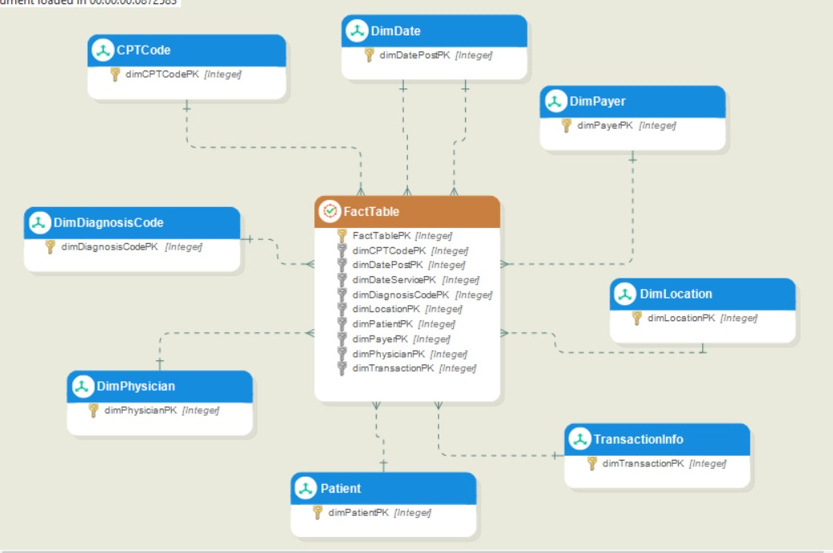
ER - Diagram of Healthcare Data

Slide 4
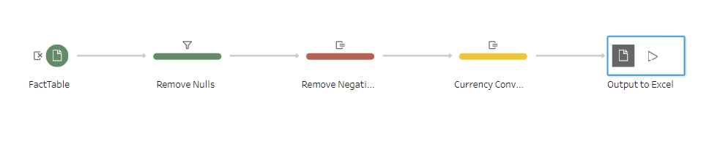
ETL operations – FactTable (½)
We have observed some of the tables in this dataset has some columns that needs transformation and cleaning. For this ETL operations we have used Tableau Prep. The ETL pipeline for these tables are as follows: In the above ETL pipeline we have performed the following transformations/ cleaning steps:
When performing data cleaning during the ETL process, replacing/removing null values is an important step to ensure data quality and accuracy. In this step we added a filter which removes the records from fact table which has two or more null values in the same row.

Slide 5
ETL operations – FactTable (2/2)
Next, we convert US dollar into Euros for the respected columns. This is achieved by multiplying the field with 0.91 (current Dollar to Euro conversion rate).
We have found the values of specific coloumns are negative which are invalid, hence we convert these negative values into positive values using some expressions as follows:
IF [CPTUnits]<0 then [CPTUnits]*-1 ELSE CPTUnits END
If the value in the [CPTUnits] field is less than 0, the condition multiplies it by -1 to convert it into a positive value. If the value is greater than or equal to 0, the condition leaves it unchanged. We follow the same steps for other fields having negative values.

Slide 6
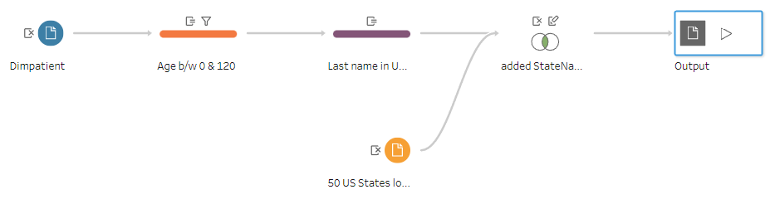
ETL operations - PATIENT
In the above ETL pipeline we have performed the following transformations/ cleaning methods:
In this we have added filter/ rule that passes only those records which has age between 0 and 120.
We have added an expression that transform the “last name” of patient to upper case.
As we have given the abbrevited code of states of USA but not their full form as we need it to represent the world map in the dashboard. So for this we have join the patients table with the lookup table “50 US States” to get the required full form.

Slide 7
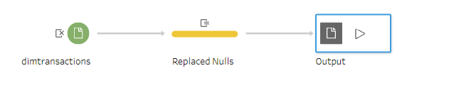
ETL operations - tRANSACTIONS
In the above ETL pipeline we have added an expression that replaces null values with hardcoded value “undefined”. We used the following Expression for this:
IFNULL([Transaction],"Undefined")

Slide 8
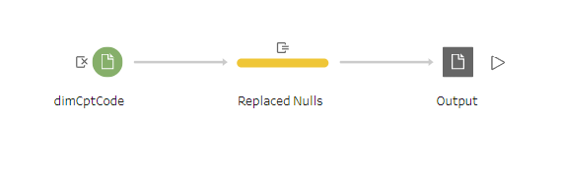
ETL operations - CPTcode
In the above ETL pipeline we also added an expression that replaces null values with hardcoded value “undefined”. We used the following Expression for this:
IFNULL([CptDesc],"Undefined")

Slide 9
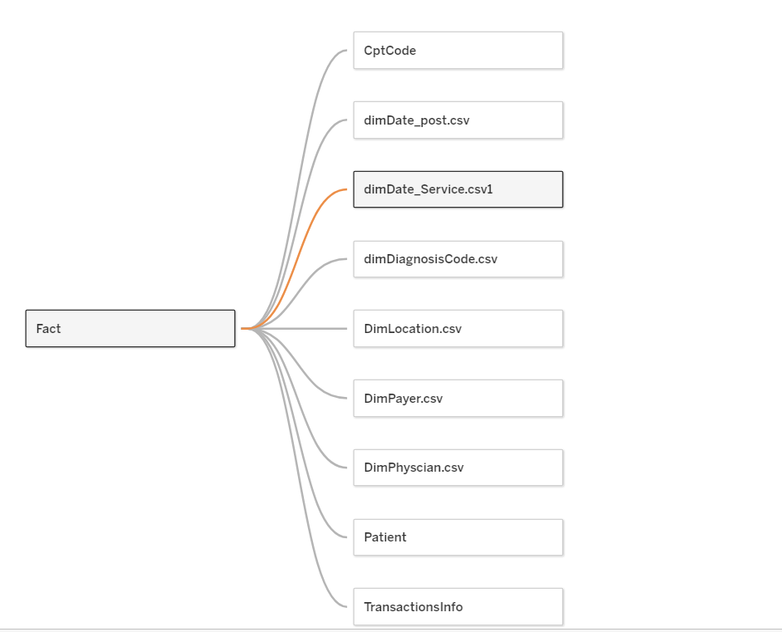
Creating Dashboards
Now after doing the necessary transformation and cleaning of the dataset, we now moved towards creating widgets and dashboards. For this we have used Tableau Desktop.
Now after we uploaded the data files, it will automatically detect & create relationships with fact table as shown.

Slide 10
Dashboard 1- Patient demographics
This dashboard answers the following business question:
The total number of unique physicians, hospital and patients?
The distribution of male and female by their individual Age & their Age group?
Number of patients by their geographical location? Which Patient Age group visits often?
Who are the top paying patients?

Slide 11
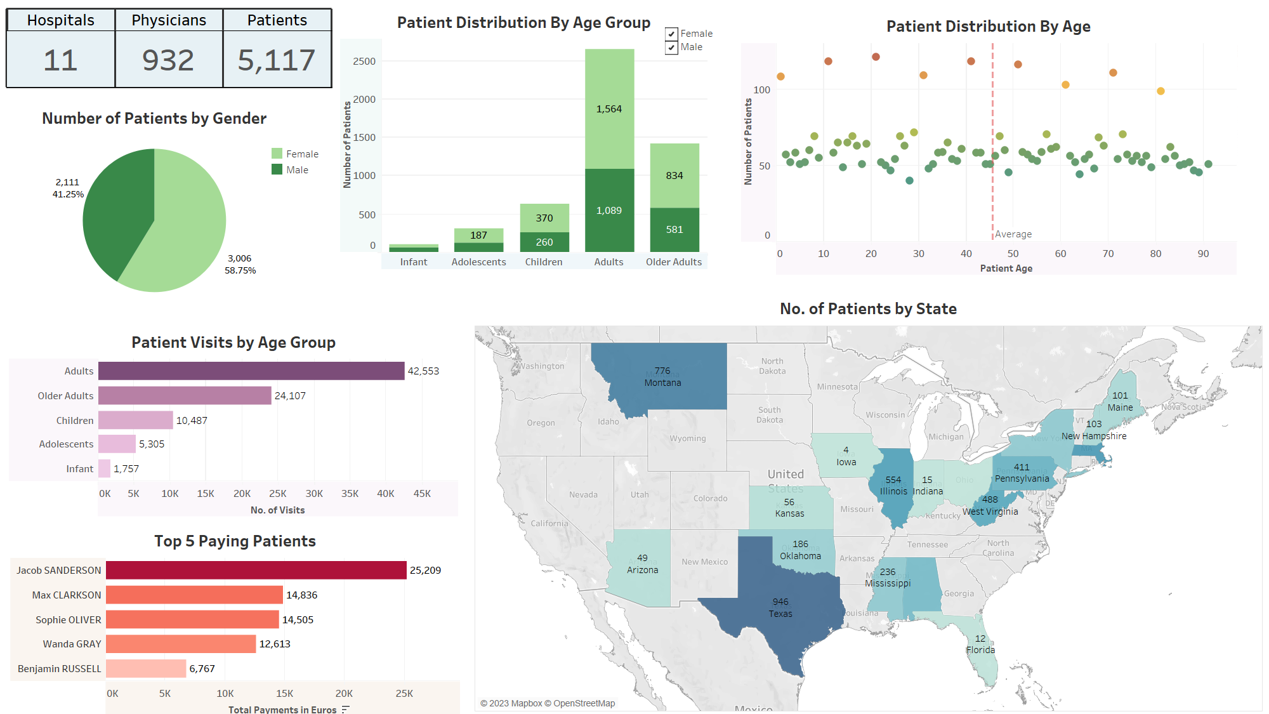

Slide 12
Dashboard 2- Physicians & Hospitals
This dashboard can answer the following question:
The distributions of physicians as per their specialty?
Number of patients visits across each hospitals yearly?
Most demanded physicians?
Distribution of Physicians in each hospital?

Slide 13
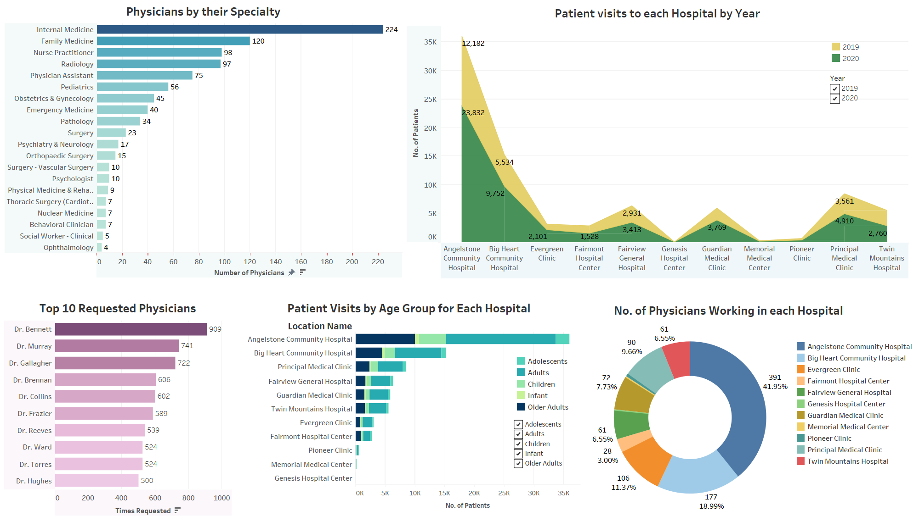

Slide 14
Dashboard 3- Diseases & Treatments
This dashboard can answer the following question:
Top diseases with respect to patient Gender?
Top diseases with respect to patient Age group?
Which treatment brings in more money?
Most prescribed treatment?

Slide 15
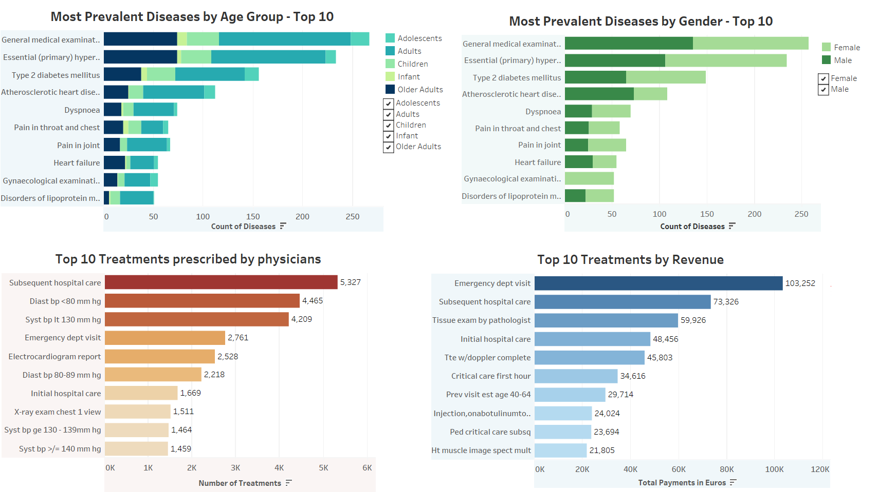

Slide 16
Dashboard 4- Payment Analysis
We can have financial insights from this dashboard:
Amount generated from each payment category?
Revenue generated from hospital each year?
Revenue generated by geographical location?
Revenue generated from each department?
Revenue generated from each patient Age group?

Slide 17
